Slide 1
Multi-Agent Robotics
George Birbilis (birbilis@zoomicon.com)
PhD student
Mechanical Engineering & Aeronautics

Slide 2
Agent
A software/hardware entity (any combination)
Has a role, a service to perform, a goal to fulfil
Perceives (via sensors) changes in its environment and reacts to them (via actuators) causing more changes to it
Can be proactive (take initiative to modify its environment, while seeking a goal state)
Is interactive and social (with human or non-human agents)
See related presentation and other material at:
http://www.mech.upatras.gr/~robgroup/agents

Slide 3
Component
Component = black box with an input (may be >1 bit), an output (may be >1 bit) and a function “f(input)->output”
Component
f(input)
Input
(>= 1bit)
Output
(>= 1bit)
Black box = don’t care how it works internally, as long as it applies its published function to the input it is given and provides the result on its output

Slide 4
System
A set of interconnected software / hardware components
Component/Parts inputs connected to outputs in a static (fixed) or dynamic (auto-reconfigurable) topology/graph
Can have feedback (loops) in the connections graph (e.g. amplifiers)
Can be seen as a coarser component / black-box, with its own input, output and “f(input)->output” function
Constituent components cooperate in order to perform the collective function “f(input)->output” of the system

Slide 5
Multi-Agent System
A group of cooperating agents that try to perform a collective function, or
a group of competing agents that may reach a dynamic equilibrium (system reacts fast to changes in the equilibrium)
Can be seen as a coarser Agent, having sensors (system input), actuators (system output) and seeking to do a role/service/goal
The grouped agents are considered to be system components
Part of the sensor & actuator networks may be exposed by the system as its own inputs/outputs, or used internally for interaction of connected (talking) parts (agents)

Slide 6
Agent-based modeling
Modeling a system as a Multi-Agent one:
Identify system’s service/goal, its role inside a bigger system / workplace
Identify discrete system parts and componentize them (define inputs, outputs and function)
Define system input (sensors), output (actuators) and role (input->output function, reaction to input changes). Using as system input and output the inputs/outputs of some of the system’s parts (I/O interface)
Define parts topology and interactions with each other (usually as a cellular automaton, defining discrete states and state transitions via message exchange)

Slide 7
Manipulators
Multi-Body physical system
N independently moving joints, a N-dof system
Joint constraints
Link chain (input link → joint → output link):
base←link1→joint1←link2→…←linkN→jointN←link(N+1)→tool tip
Force/torque feedback chain:
Input←→base←→joint1←→…←→jointN←→tool tip←→Output
Robot workspace: all physical configurations
Non-free workspace: configurations colliding with obstacles
Free workspace: Robot workspace – Obstacles

Slide 8
Manipulator multi-agent model
Each joint considered an Agent
Each joint has an input and an output
Can sense current or incoming collisions on its output link and notify previous and next joint
Can propagate collision messages received from adjacent joints up and down the link chain
A highly redundant manipulator can follow tool tip trajectory like a snake (Maciejewski and Klein [1985], see Hwang/Ahuja Motion planning survey, p.268)

Slide 9
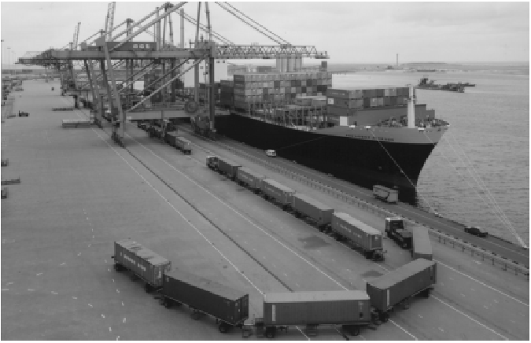
Road trains
Trains with no tracks, made up of many wagons following a pulling track. Wagons seem to follow smooth curve of track’s motion, see:
http://www.adams.com/news/events/userconf/euro/1998/euc98_28.pdf

Slide 10
In progress…
Building 2D space with obstacles and manipulators in Microsoft .NET (using Visual Basic.NET)
Manipulator object hosting collection of Joint objects interconnected via Link objects
Try to solve redundant planar manipulator seeking points inside a toroid having a small opening for manipulator entrance. See Aspragathos & Hewit [1983], “Kinematic Control of a Planar Manipulator with Access Constraints”

